Slide 1
Generating Deep Fake Images using GANs
Sahithi Kodali - 34789866 Mayesha Monjur - 35773359

Slide 2
Introduction
Problem Statement
Investigating the process of deepfake image generation to effectively address and alleviate the potential risks and challenges associated with this technology.
This project aims to explore how Generative Adversarial Networks(GANs) can be used to generate deep fake images.
Motivation
Real-world applications - Various applications in fields such as entertainment, advertising, and data augmentation for machine learning.
Ethical concerns and countermeasures - Essential to understand GAN models to develop countermeasures against malicious uses of deepfake technology.
Expanding the research landscape - Study of GAN can provide valuable insights into their underlying mechanisms and inspire further research into the development of more advanced and efficient models.
Dataset
Large-scale CelebFaces Attributes (CelebA) Dataset from Kaggle.

Slide 3
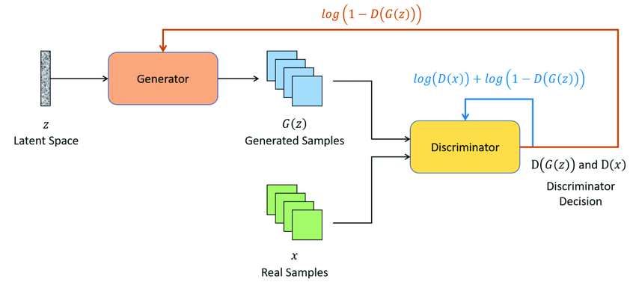
Generative Adversarial Networks (GANs)
GANs are the generative models that create new data instances from noise distribution which are similar to the training data.
Works based on the min-max optimization.
Automatic Target Recognition for Low Resolution Foliage Penetrating SAR Images Using CNNs and GANs - Scientific Figure on ResearchGate. Available from: https://www.researchgate.net/figure/Typical-Generative-Adversarial-Networks-GAN-architecture_fig2_349182009 [accessed 25 Apr, 2023]
Notes:
It works based on min-max optimization.
While discriminator tries to maximize the average of the log probability of real images and the log of the inverse probability for fake images, generator tries to minimize the log of the inverse probability of fake images predicted by the discriminator.

Slide 4
GAN models
In this project three types of GANs have been experimented
Vanilla GAN
Deep Convolutional GAN (DCGAN)
Wasserstein GAN (WGAN)
Using weight clipping
Using gradient penalty

Slide 5
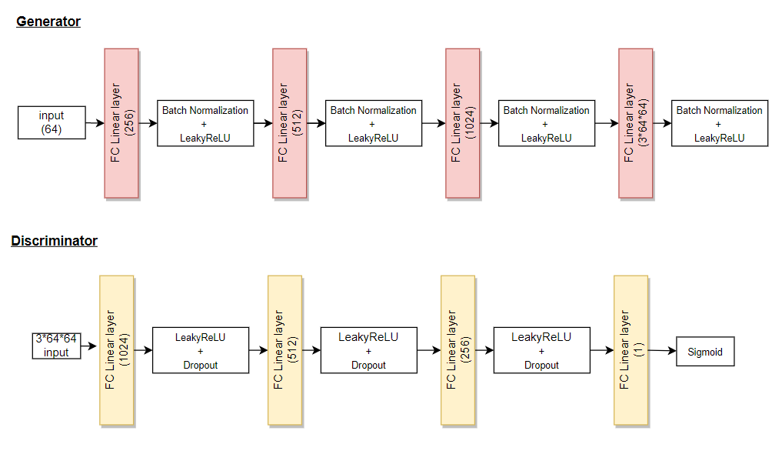
Vanilla GAN
Architecture - Using linear layers only

Slide 6
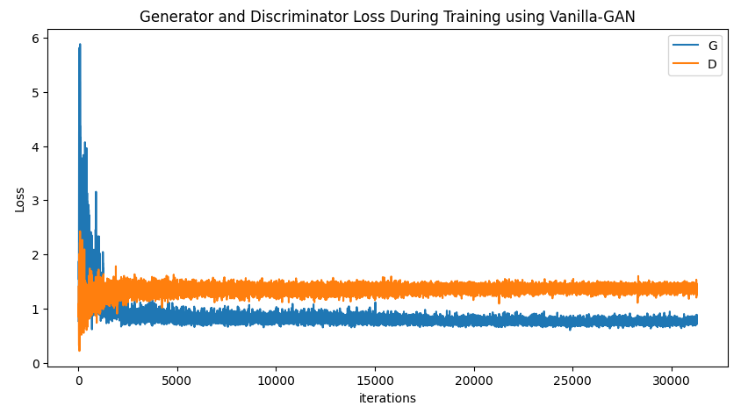
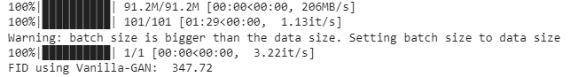
Vanilla GAN
Results

Slide 7
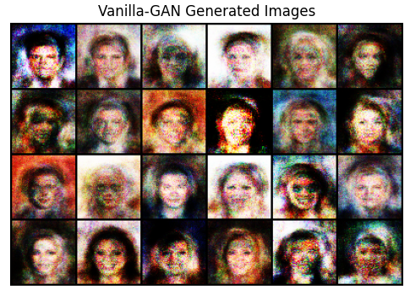
Vanilla GAN
Results

Slide 8
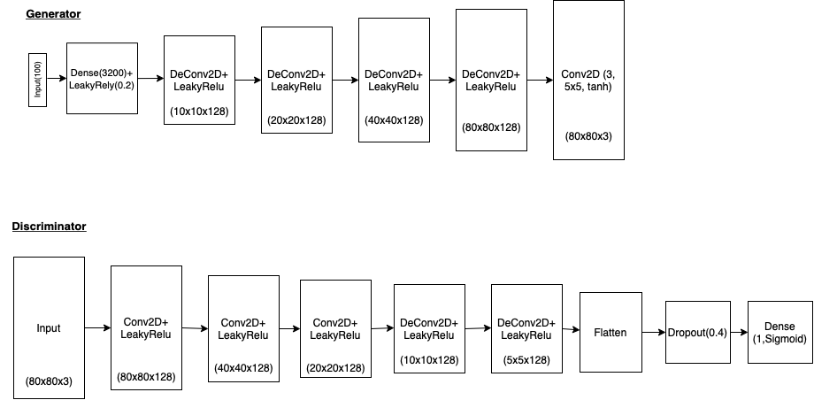
Deep Convolutional Generative Adversarial Networks (DC-GAN)
Architecture

Slide 9
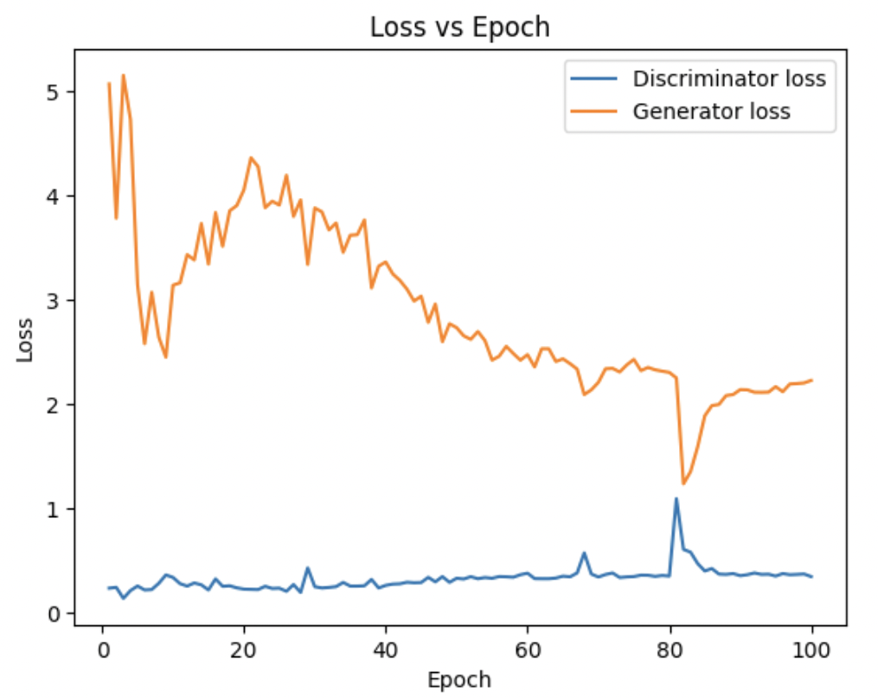
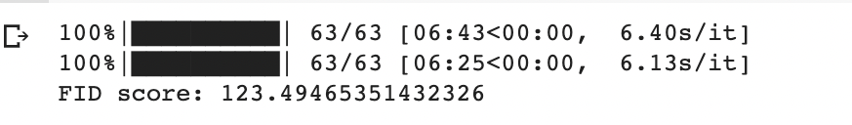
Deep Convolutional Generative Adversarial Networks (DC-GAN)
Results

Slide 10
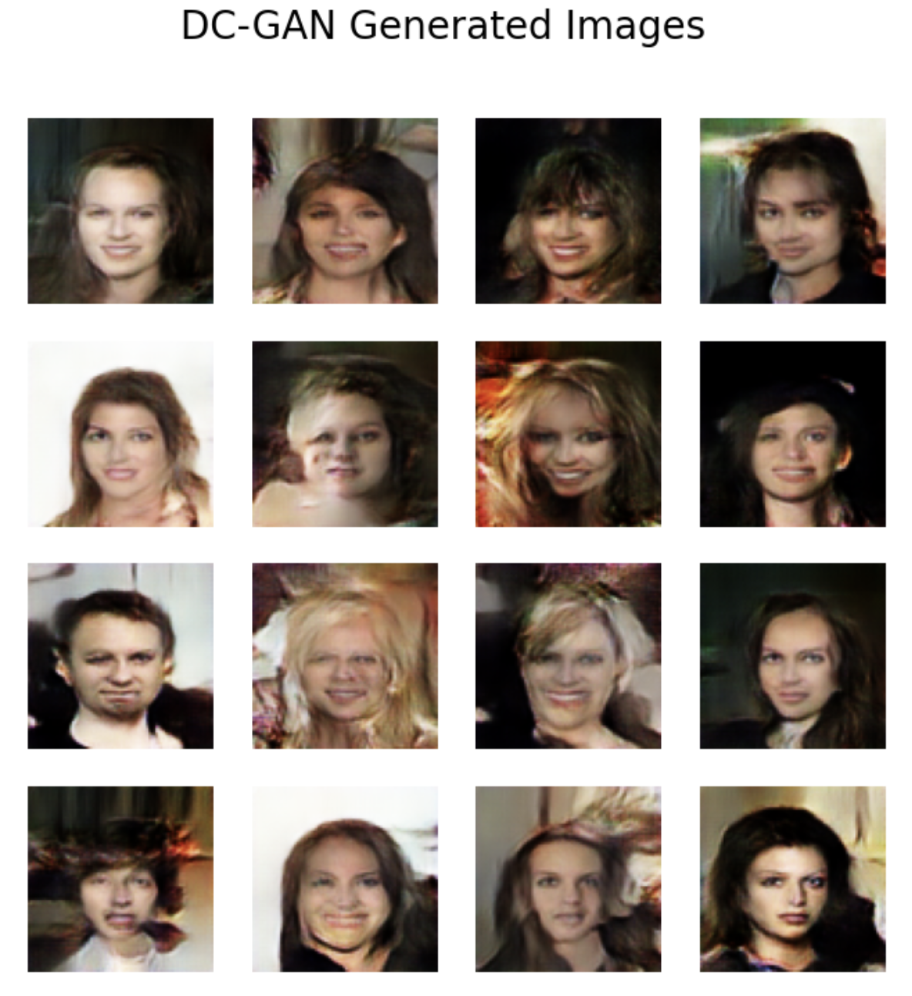
Deep Convolutional Generative Adversarial Networks (DC-GAN)
Results

Slide 11
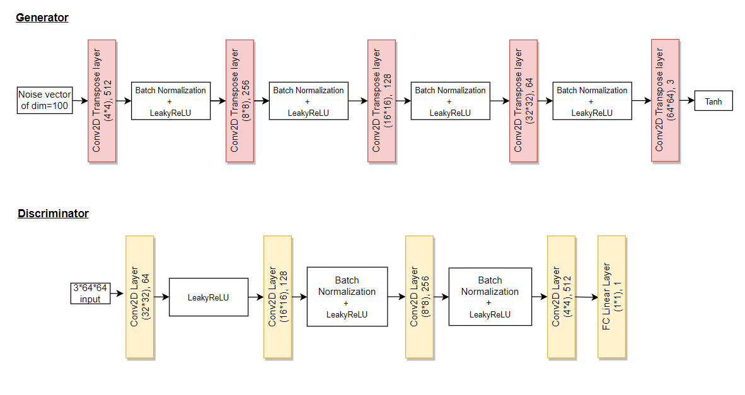
Wasserstein GAN (WGAN)
Architecture - Using weight clipping

Slide 12
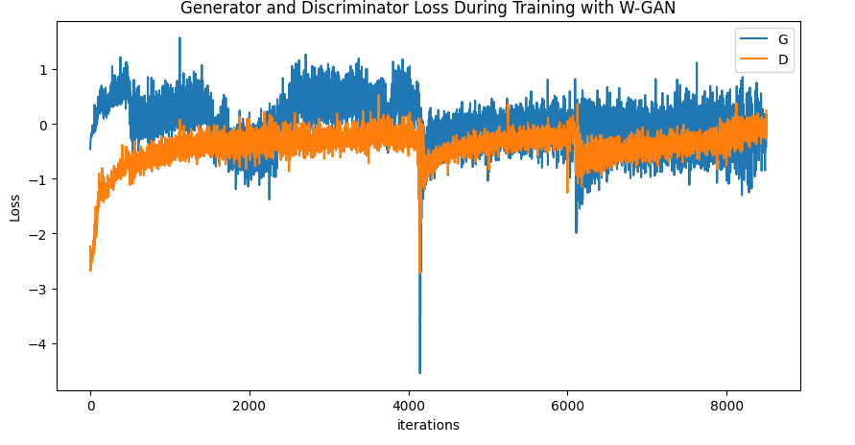
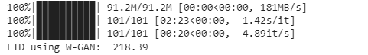
Wasserstein GAN (WGAN)
Results - Using weight clipping

Slide 13
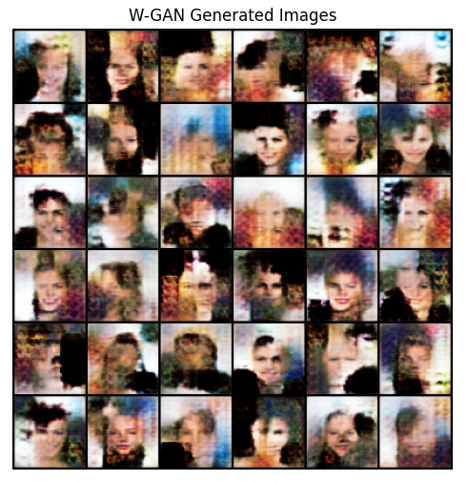
Wasserstein GAN (WGAN)
Results - Using weight clipping

Slide 14
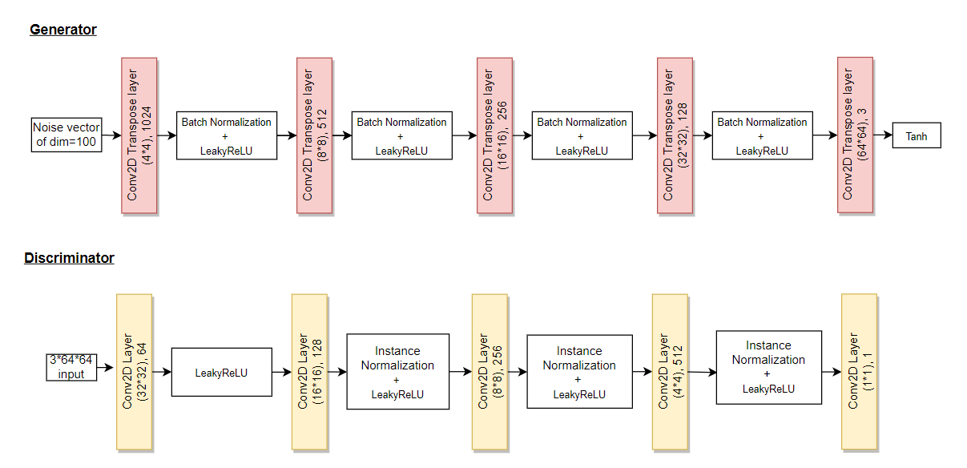
Wasserstein GAN (WGAN)
Architecture - Using gradient penalty

Slide 15
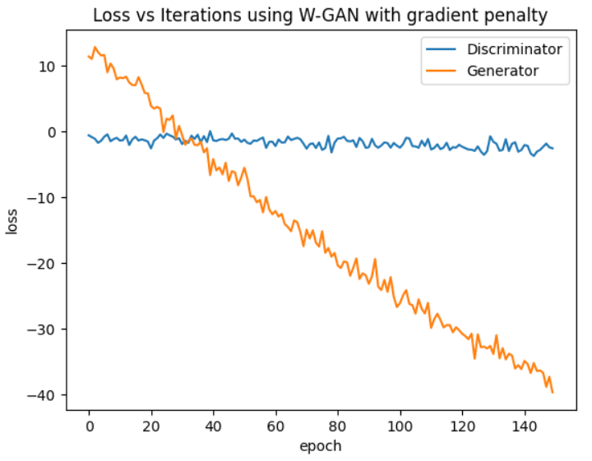
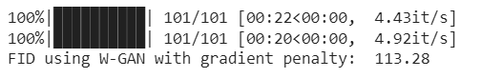
Wasserstein GAN (WGAN)
Results - Using gradient penalty

Slide 16
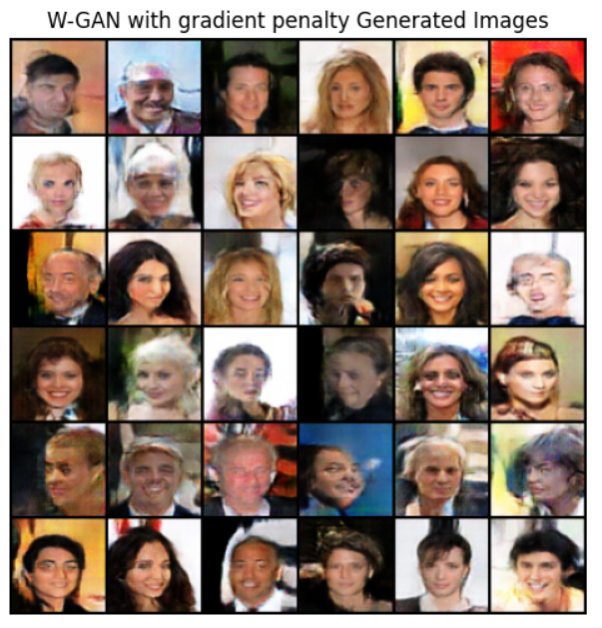
Wasserstein GAN (WGAN)
Results- Using gradient penalty

Slide 17
Results and Analysis
WGAN with gradient penalty produced the best quantitative and qualitative results, followed by DCGAN.
Vanilla GAN produced the worst results, which is understandable due to the use of only linear layers.
WGAN using weights clipping can be further improved by using more data and more epochs for training, which is also true for all other models.
Drawbacks:
Requires large amount of data and thus computational time.
Mode collapse need to be observed.
Instability in training GANs.

Slide 18
Conclusion
Implications of the results in the field of deepfake
Model Selection - Can be helpful for making informed decisions while selecting a model for deepfake image generation.
Improved Techniques - Can inspire new techniques and modifications to improve the performance of GANs.
Model Interpretability - Can shed light on the reasons behind the performance differences among the GAN models, potentially leading to better model interpretability and explainability
Future work/ Potential improvements
Deepfake detection
Explore advanced GANs

Slide 19
THANK YOU
Q/A

